Slide 1

Decision by written procedures
LEP Board
1 October 2019
Richard Kendall
Karen Oliver-Spry

Slide 2
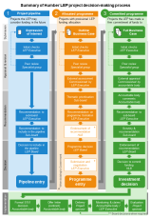
Background and summary of recommendations
The LEP’s decision-making process* takes projects through three stages:
  Project pipeline – projects the LEP may consider funding in the future
  Allocated programme – projects with a provisional funding allocation from the LEP
  Committed programme – projects the LEP has made a firm commitment of funds to,
  which then move into delivery
Following external appraisal of the Full Business Case and review by the Investment and Regulation Board, the LEP Board is recommended to make the following decision:
  Agree that £3,260,943 funding commitment from the Local Growth Fund is made to Brough Relief Road (Phase 3)
  * See http://www.humberlep.org/assurance/project-decision-making-process/ for details

Slide 3
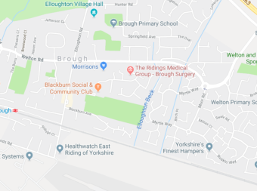
Decision: Brough Relief Road (Phase 3)
Brough Relief Road (BRR) is an essential piece of infrastructure that links the new Brough South Development with the western side of Brough, while also providing new access for the Humber Enterprise Park (HEP) Enterprise Zone site.
BRR Phase 3 is the missing link that provides the third and final stage of the Relief Road by connecting the southern point of Skillings Lane with Moor Road (part of Phases 1 and 2). Once complete the scheme will:
• Improve access to the Humber Enterprise Park (HEP)
• Ease town centre congestion
• Unlock economic land as part of the Brough South development
Access to and from the HEP will be critical to its success and delivery of the Enterprise Zone objectives. Since HEP was awarded EZ status a number of high-profile investments (which the LEP is aware of) have gone elsewhere due to the existing access arrangements. By removing existing access constraints and enabling commercial traffic to avoid the centre of Brough it will help alleviate congestion, improve safety and provide users of HEP with an appropriate access.
Traffic, especially HGVs, will be diverted on to the new link providing benefit to the residents of Brough and surrounding areas.
Phase 3 also facilitates access to the western side of the Brough South development and will help attract interest, including a food store, and help accelerate development. This development and enhanced connectivity will also benefit residents through improved journeys and access to local services and employment.
The link road has outline planning approval as part of the wider Brough South Masterplan and its provision is linked to development quantum via a Section 106 agreement. Due to viability issues related to abnormal costs associated with flooding, the anticipated timescale for delivery if left to market forces is estimated at 10 years plus. Therefore, public money is required to accelerate delivery, so the growth ambitions and desired outcomes can be realised within the current Strategic Economic Plan and Enterprise Zone delivery plan periods.
A summary of the independent technical appraisal can be found at Annex 1.
The Investment and Regulation Board recommends to the LEP Board that £3,260,943 is committed from the Local Growth Fund to Brough Relief Road (Phase 3).
Funding (£)
LGF | £3,260,943
ERYC | £1,630,471
Private Sector (Horncastle Group) | £1,630,471
Total | £6,521,885
Outputs
Jobs Created | 600
Construction Jobs | 150
Housing Units Started & Completed | 550
Newly Build Road & Cycle way (Km) | 0.7
Area of new development sites (ha) (Residential) | 25
Area of new development sites (ha) (Industrial) | 60
Commercial Floorspace created & occupied (m²) | 17243
Area of land with reduced likelihood of flooding (ha) | 50

