Slide 1
Hull & East Yorkshire Local Enterprise Partnership
COVID-19 Impact Assessment
Update Report – October 2021

Slide 2
Contents
1) Economic Impact
2) Impact on Business
3) Impact on People
4) Impact on Place

Slide 3
2
Economic Impact

Slide 4
GVA Impact of COVID
GVA Loss by Sector (£m), 2020
The Humber region’s GVA was £21bn in 2019.
Modelling estimates that £1.7bn, or 8%, of that was lost during 2020, which is slightly below the estimated loss rate for the national economy (9.8%).
Similarly, Hull and East Riding’s GVA was about £13.4bn in 2019 and the area also experienced an 8% loss in output over the course of 2020.
Source: Hatch analysis of OBR Economic and fiscal outlook – March 2021 & October 2021

Slide 5
GVA Recovery Scenarios
Total GVA Impact and Recovery Scenarios (£m)
The OBR forecasts growth to be about 6.5% in 2021, 6% in 2022, declining to 2.1% in 2023 and ranging from 1.3% to 1.7%
Scenario A: based on the respective historic real growth rates per annum going forward
Scenario B: based on OBR’s October growth forecast for the national economy.
Humber and Hull and East Riding need to achieve a growth rate well above their historic rates to get back to their pre-COVID trajectory in the short to medium term.
Source: Hatch analysis of OBR Economic and fiscal outlook – March 2021 & October 2021
Note: Figures for 2019 onwards are in 2020 prices

Slide 6
5
Impact on Business

Slide 7
Temporary Closures
Estimated proportion of businesses open and trading for at least two weeks, UK
Latest national Business Impact of Coronavirus Survey (BICS) survey in October 2021 shows:
89% of businesses across the UK have been open and trading for at least two weeks, following COVID-related closures
11% of businesses have not restarted trading
Applying these assumptions to the HEY business base, of the approximately 20k businesses based in Hull and East Yorkshire, over 2,000 are likely to not have resumed trading.
Source: BICS, ONS, 2021

Slide 8
Use of Support Schemes
Use by Business of Government Support Schemes as of October 2021, UK
35% of businesses* are estimated to be using/intending to use support schemes as of October 2021.
Some sectors are more likely than others to access them, with almost two thirds of accommodation and food businesses estimated to be utilizing them.
Applying HEY LEP business count data to national figures suggests that 1,000 businesses in this sector are estimated to be receiving support in this region.
Manufacturing is also one of the sectors with above average uptake of support, with just under 50% of businesses in this sector receiving support. This equates to approximately 700 firms when applying HEY LEP business count data.
Source: BICS, ONS, 2021, Hatch Analysis. *Please note, percentages are derived at the national level, and applied to HEY LEP business counts

Slide 9
Cash Reserves
Estimated Levels of Business Cash Reserves, June 2020 – October 2021, UK
October BIC survey of business cash reserves shows:
Situation as of October 2021 has deteriorated since the last update (April 2021), with the proportion of businesses reporting no cash reserves having more than doubled to 11% from 5%
Applying this to the HEY region suggests that within approximately 10,300 businesses have less than six months cash, while over 7.5k have at most 3 months of cash reserves, placing them in a high-risk position.
Construction has emerged as a sector for acute concern, with 16% of firms reporting no cash reserves in October 2021, up from 6% in April 2021.
Source: BICS, ONS, 2021

Slide 10
Insolvencies
Insolvencies, 2020 to September 2021
Peak insolvencies in Humber (29 insolvencies) and in HEY area (23 insolvencies) during first national lockdown.
Level of insolvencies not sustained, likely as a result of government business support programmes
Other periods also saw insolvency levels rise, notably in February and March 2021, during the third national lockdown.
Business insolvencies in the HEY have reduced since March 2021 but Hull is displaying signs of increasing.
Source: The Gazette, Hatch analysis

Slide 11
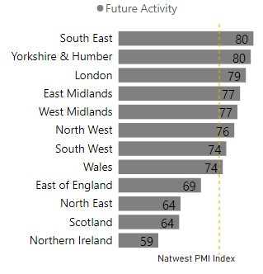
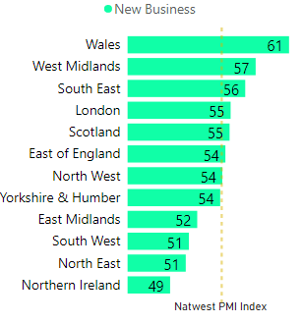
Purchasing Managers Index (PMI)
Growing optimism in the 12-month outlook of the Yorkshire and Humber with orders and planning for future activity indicating much higher than average output in this region, compared to other regions and the UK. Sentiment in the Yorkshire and Humber region was the second strongest across all 12 regions as of September 2021.
Real-time metric that is considered to be a leading indicator of GDP. It is a wide survey of UK businesses and measures the volume of new orders placed. Responses below 50 indicate a decrease in new orders and responses above 50 indicate expansion.
New orders placed with in Yorkshire & Humber experienced a fall in early 2021
Q3 of 2021 shows recovery with the region showing a positive index of 55 (above 50 indicating growth). The rate of recovery in the region is in line with the UK.
Future Activity Index, September 2021
New Business Index, September 2021
National average
National average
Source: NatWest PMI

Slide 12
Business Incorporations
Business incorporations, 2020 and 2021 to October
Approaching the final quarter of 2021, current total of new businesses in the HEY LEP area is about 76% that of all new businesses registered in 2020 and 74% Humber-wide.
Performance in Kingston upon Hull is notable, with almost 1,300 new incorporations, representing 79% of 2020’s total with one quarter of the year left to go.
The East Riding shows 1,550 incorporations, representing 74% of the previous year’s total as we approach Q4 2021.
Humber figures incorporate North Lincolnshire which lag behind HEY and North East Lincolnshire.
Business incorporations by sector, Hull and East Yorkshire, 2021
Source: Hatch analysis of Companies House, HMRC, 2019-2021

Slide 13
Business Exports
How well are you managing with the new UK-EU trading relationship?
An April 2021 survey conducted by DIT for the LEP found that most businesses in the Humber were broadly managing the new UK-EU trading relationship.
Since then, a developing set of issues has come to affect exporting businesses in the Hull and East Yorkshire area including:
Recruitment / staff shortages. This shortage disproportionately affects businesses who export physical goods, of which the HEY area has a high density.
Logistical difficulties not down to a single cause, with the impact of EU exit and the pandemic interacting.
Inflation has been rising rapidly in the last six months of 2021, going from well below the Bank of England’s target of 2% to over 3% by September 2021 resulting in an increase in the cost of materials and issues for manufacturing.
UK Inflation (CPI)
Source: Humber Levelling Up Study, Hull and East Yorkshire Local Enterprise Partnership and Department for International Trade, April 2021; Bank of England; local business intelligence from the HEY LEP

Slide 14
16
Impact on People

Slide 15
Claimant count
Claimant Count (% of residents aged 16-64), February 2020 to September 2021
March 2020-21 - increase in the claimant count across the HEY and Humber LEP areas.
Rate of claimants during this time likely depressed by the CJRS (furlough scheme).
September 2021 - claimant count rate has been steadily decreasing from the post-pandemic peak in all areas of the HEY and Humber LEP areas.
Risk of increasing numbers of claimants looks unlikely due to the rising number of job vacancies during Q3 2021.
Source: UK Claimant Count, ONS, 2020 – 2021

Slide 16
Furloughed Employment (1)
Data for the month of August 2021 (data released November 2021) shows the rate of furlough in the HEY and Humber LEP regions is now low, ahead of the schemes termination.
Over the past 9-month period where data has been released, the furlough rate in the HEY has generally been slightly below the national rate.
% of Employments Furloughed July 2020 – September 2021
December: Second national lockdown ends
October: Tiered lockdown policy – with Yorkshire & Humber placed in tier 3
% of Employments Furloughed as of September 2021*
January: Third national lockdown begins
August: Eat Out to Help Out scheme opens
March: Third lockdown eases with “roadmap out of lockdown”
November: Second national lockdown begins
Source: Coronavirus Job Retention Scheme Statistics, ONS, October 2021; BRES, ONS, 2020
* Data released October 2021

Slide 17
Furloughed Employment (2)
Broad Sector Furlough Rates as % of Broad Sector Employment, as of August 2021
HEY and Humber LEP area furlough rates by sector are broadly aligned to the national sectoral rates.
Furlough in the HEY area is substantially below the national rate for certain sectors including administrative and support services, ICT and logistics.
Latest data shows a contrast with previous furlough data, with only one sector furloughing at a rate above 15% in the Humber region, namely wholesale and retail (previously ICT)
Despite rapidly falling rates of furlough in the accommodation & food and wholesale & retail sectors brought on by the lockdown easings, they remain the highest sectors.
Source: Coronavirus Job Retention Scheme Statistics, ONS, May 2021; BRES, ONS, 2020
* Note figures for April 2021 are currently provisional and may change

Slide 18
Self-employment Income Support
Alongside the employment furlough scheme, the UK government initiated the self employment income support scheme (SEIS) for self employment individuals.
Take up rate of the SEIS for the fifth grant (November 2021) shows Hull retaining the highest rate of take-up from the programme.
Data shows that the average claim in Hull for SEIS support was also lower than all comparator areas. The inverse is true for East Riding where take-up has been lower under this round (25%) but the average claim value has been closer to the national average at £2.2k.
% Take-up and Average SEIS Claim
16-64 Self Employment Rates, June 2021
England rate = 10%
Source: Self-Employment Income Support Scheme statistics, HMRC, November 2021

Slide 19
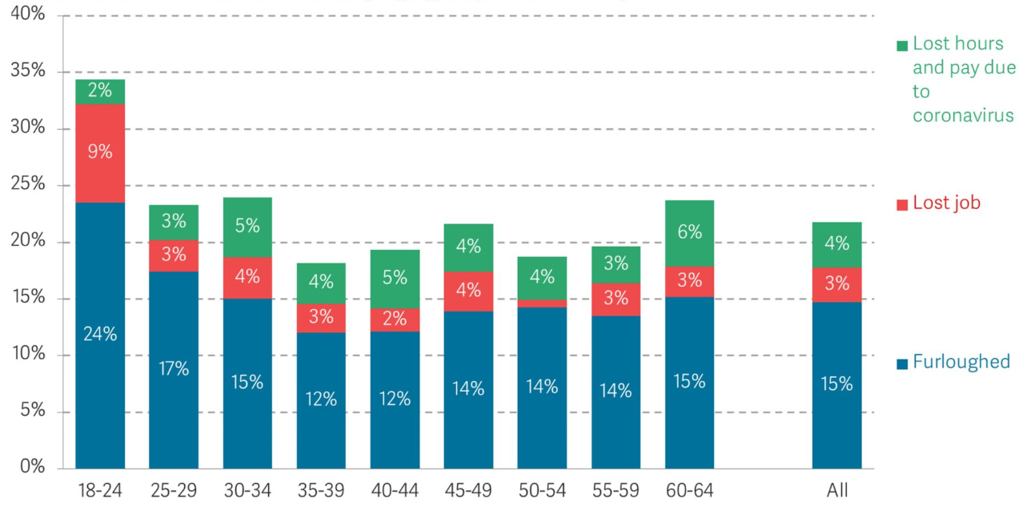
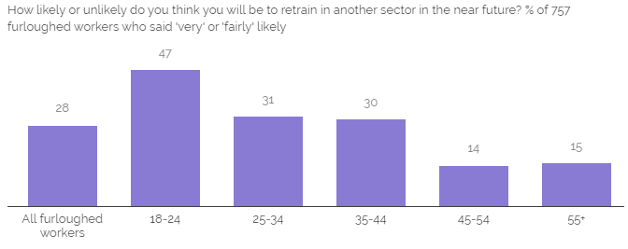
Generational Impact of Covid-19
Generational Impacts of Covid in England (% of age group)
Young people are being disproportionately impacted by COVID at the national level.
Large proportion of 18-24-year-olds on furlough
Many young people require part-time jobs in order to finance HE and FE degrees.
Reduction in apprenticeship positions with some apprentices losing their position just months before the completion of training.
Higher risk of long term unemployment and pay scarring
YouGov surveyed furloughed workers again in March 2021 and found younger people are more likely to switch employment sector.
Likelihood of switching sector of furloughed workers by age
Source: Hatch analysis of YouGov data, March 2021

Slide 20
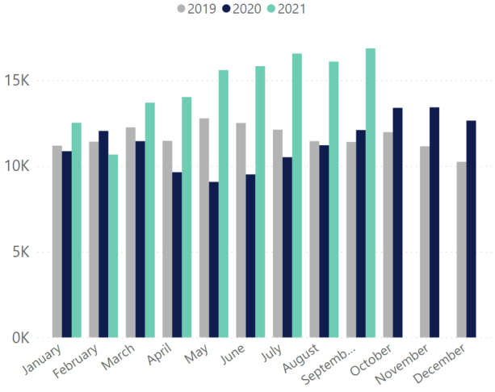
Job Postings
Unique Job Postings in Hull and East Yorkshire, 2019 - 2021
Job postings in a phase of rapid growth, both in the HEY area and nationally.
From the most recent trough during the third national lockdown in February 2021, postings have grown by a total of +58% as of September 2021 in the HEY area (+50% for England).
Job Postings in Hull and East Yorkshire, 2016 - 2021
Source: Hatch analysis of EMSI data, 2019-2021

Slide 21
Hull and East Yorkshire Job Postings – Top 20 Vacancies by Role Sept’ 20 – Sept’ 2021
SOC Occupation | Unique job postings
Nurses | 3,477
Care workers and home carers | 2,492
Van drivers | 2,080
Other administrative occupations n.e.c. | 1,979
Elementary storage occupations | 1,940
Primary and nursery education teaching professionals | 1,715
Sales accounts and business development managers | 1,556
Metal working production and maintenance fitters | 1,522
Book-keepers, payroll managers and wages clerks | 1,428
Cleaners and domestics | 1,310
Sales and retail assistants | 1,243
Nursing auxiliaries and assistants | 1,168
Kitchen and catering assistants | 1,068
Electricians and electrical fitters | 1,025
Teaching assistants | 994
Business sales executives | 980
Medical practitioners | 971
Chefs | 935
Production managers and directors in manufacturing | 933
Programmers and software development professionals | 930
Source: Hatch analysis of EMSI data, 2020-21

Slide 22
Apprenticeship starts
Apprenticeship starts in Humber and HEY Area, Q2 2017 – Q2 2020
Apprenticeship starts in Q2 2017 – Q2 2020 across the Humber’s local authorities
Source: Humber DataCube

Slide 23
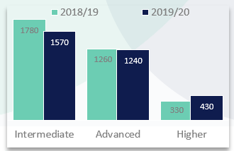
Apprenticeship Levels & Subject Starts
Over 90% of apprenticeship starts in the Humber LEP region in 2019/20 were in five subject areas:
Retail and commercial enterprise – 990 apprenticeships
Business admin and law – 760 apprenticeships
Engineering and manufacturing – 630 apprenticeships
Health, public services and care – 490 apprenticeships
Construction – 260 apprenticeships
[Caution required when interpreting apprenticeship data – age, level and levy use]
Humber Apprenticeship Subject Starts, 2018/19 – 2019/20
Humber Apprenticeship Levels, 2018/19 – 2019/20
Source: Humber DataCube

Slide 24
29
Impact on Place
Notes:
Consider how to increase font to 10.5 arial

Slide 25
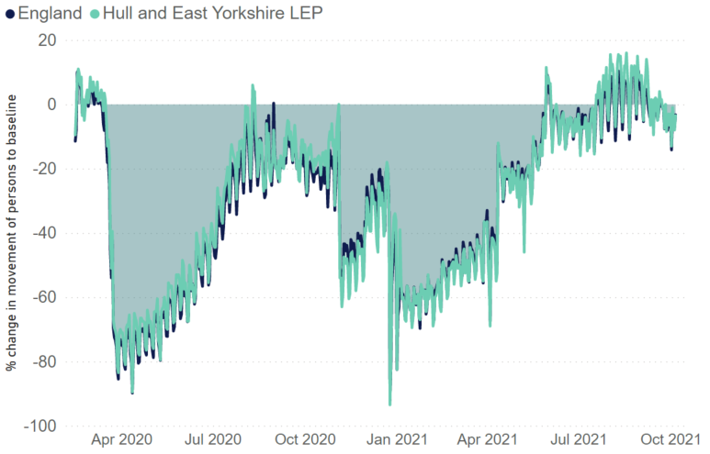
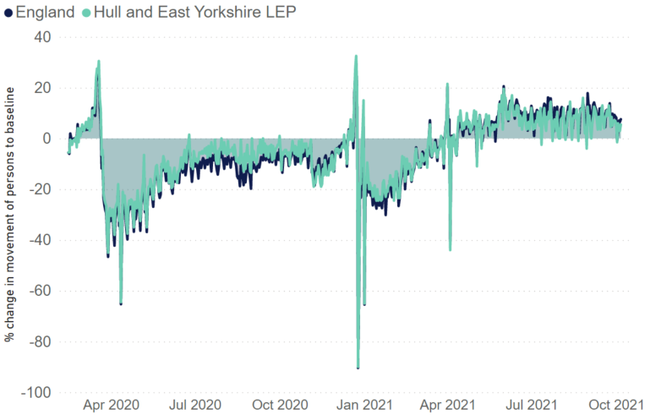
Mobility (1)
Retail
Grocery
National Lockdown
National Lockdown
Grocery stores and pharmacies have been allowed to continue to trade and show a return to higher levels than pre-pandemic.
Decline in non-essential retail has been stark during the course of the pandemic.
Hull and East Yorkshire area has been broadly aligned with the national average and as of October 2021, people have virtually returned to pre-pandemic levels of visiting retail shops.
Since February 2020, Google have released mobility data that records numbers of using location proxies including workplaces, transit stations, non-essential retailers and essential retailers. The mobility statistics are measured against a baseline of 0, which is the median mobility value from the five-week period before COVID. Google’s methodology uses data from Google users who have opted into Location History for their Google Account, so that the data represents a sample of our users. As with all samples, this may or may not represent the exact behavior of a wider population.
Source: Google Mobility data, Hatch analysis

Slide 26
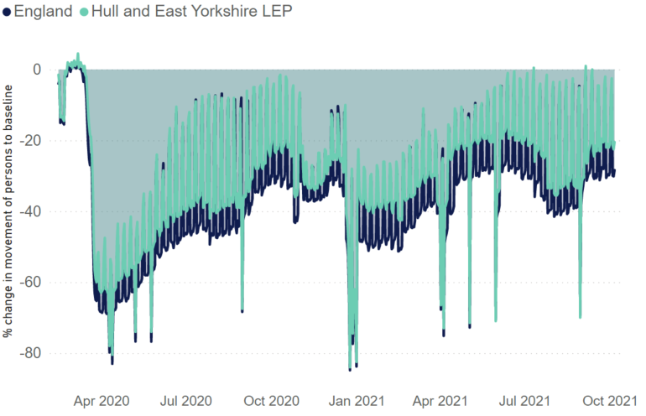
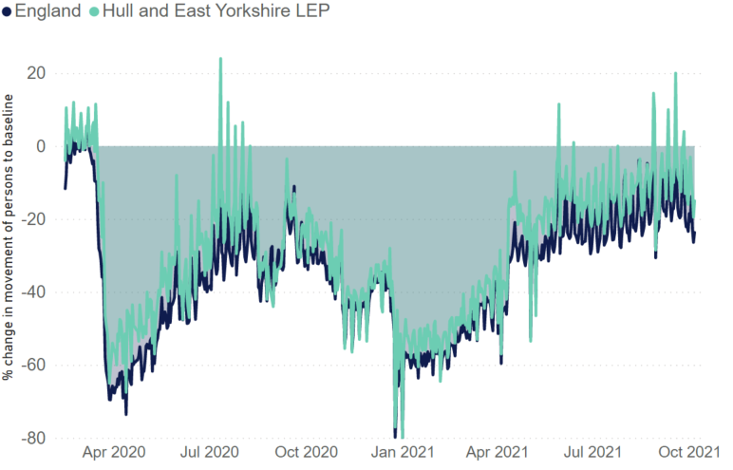
Mobility (2)
Workplace
Transit
National Lockdown
National Lockdown
National Lockdown
Since the start of lockdown the national levels of workplace mobility have been approximately 8% more impacted compared to Hull and East Yorkshire. This showing that more people in the LEP area have been travelling to work compared to the national level.
As of October 2021, however, movement of people to workplaces remains well below the pre-pandemic benchmark.
Usage of transit stations shows is relatively similar between the HEY LEP area and national.
As of October 2021, usage of transit appears to have plateaued at around 20% less than the pre-pandemic benchmark for Hull and East Yorkshire (26% nationally). This likely reflects robust trends of remote working.
Source: Google Mobility data, Hatch analysis

Slide 27
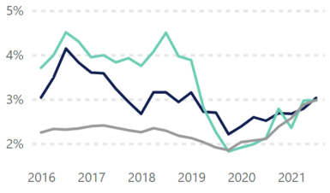
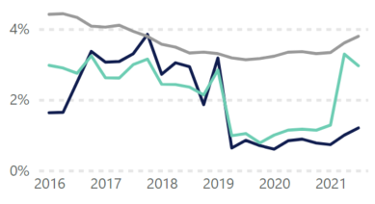
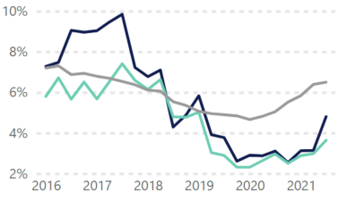
Commercial Property
Vacancy Rates
Levels of commercial vacancy rates vary by type. Each of these graphs shows the change in vacancy rates in the Humber, the HEY area and in England.
Retail Vacancy Rates
Industrial Vacancy Rates
Low office vacancy rates have held firm throughout most of the pandemic
Now signs of increasing office vacancies across each of the three areas, including a sharp jump in the HEY in the most recent quarter (Q2 2021).
2021 Q2
2021 Q2
Office Vacancy Rates
2021 Q2
Retail vacancy rates - higher in both the Humber and Hull and East Yorkshire
Have broadly followed the national trend of a decline since around 2019, before climbing steadily since the onset of the pandemic.
Rate of increasing retail vacancy has held since the previous iteration of this report. In spite of the pandemic, however, vacancy rates remain below the pre-pandemic peak.
Industrial vacancy rates have been more pronounced in the Humber and Hull and East Yorkshire than England
Reduced rates since 2019 have held steady showing a recent spike in the Humber in 2021.
Consisting of the fewest number of transactions, the Industrial property market vacancy rate is more sensitive to a smaller number of (or even individual) transactions than Office or Retail.
Source: Co-star, Hatch analysis

Slide 28
Commercial Property
Take-up Rates
Commercial Property Transactions Index Change
(2011 Q1 = 100)
Take-up has been consistently buoyant in Hull and East Yorkshire compared to the national average.
A dip in take-up occurred as a result of the first and the third national lockdowns (i.e. spring to summer 2020 and winter 2021), although principally across Humber rather than in HEY itself.
Following the easing of restrictions in spring 2021, the net absorption rate rebounded in the HEY area, an encouraging contrast to the small dip nationally.
Source: Co-star, Hatch analysis

Slide 29
Thank You
Chris Howell
Employment & Skills Manager
E: c.howell@heylep.com
M: 07912 299599

